Slide 1


Amazon Prime Video Dashboard and Content Analytics Using
Power BI

Slide 2

Table of content
1. Introduction
2. Workflow of Power BI Project
3. Data Import and Transformation
4. Data Modelling
5. Visualization and Report Building
6. Dashboard and Publishing
7. Insights and Findings
8. Best Practices and Tips
9. Conclusion
10. Appendices
This Photo by Unknown Author is licensed under CC BY-SA

Slide 3
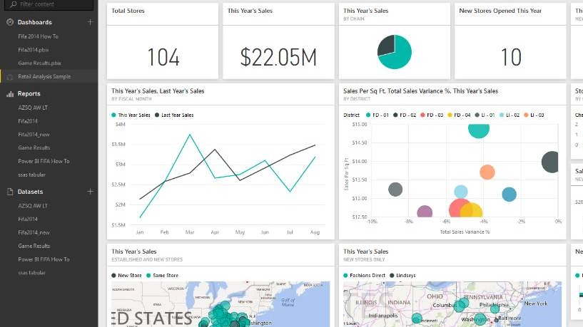
Introduction
Overview:
This Power BI project analyzes the Amazon Prime Video dataset to understand trends in movies and TV shows released from 1920 to 2021.
The goal is to extract insights about content production patterns, genre popularity, country-wise distribution, and overall growth trends.
Objective:
To build an interactive Power BI dashboard that visualizes:
Content count by genre, release year, and country
Directors and actors with the highest contributions
Movie vs. TV Show distribution
Insights into platform evolution over time
This Photo by Unknown Author is licensed under CC BY-SA-NC

Slide 4
Workflow of Power BI Project
Step | Stage | Description
1 | Data Import | Imported dataset amazon_prime_titles.csv from Kaggle into Power BI.
2 | Data Transformation | Cleaned and formatted data using Power Query (removed nulls, duplicates, and formatted dates).
3 | Data Modelling | Defined relationships and calculated fields such as content count, year trends, and genre distribution.
4 | Visualization | Designed visuals for genres, years, and directors with KPIs and filters.
5 | Dashboard Publishing | Published the final dashboard to Power BI Service for easy access and sharing.

Slide 5

Data Import and Transformation
Data Source:
Dataset: amazon_prime_titles.csv
Attributes include: show_id, type, title, director, cast, country, release_year, rating, duration, listed_in, and description.
Cleaning Steps:
Removed duplicates and empty cells (especially in director and country).
Standardized text fields and formatted release_year as date type.
Split multi-valued fields (e.g., genres and actors) for better analysis.
Added calculated columns such as content_age (2021 – release_year).
Outcome:
The cleaned dataset was well-structured and optimized for visual analytics.
This Photo by Unknown Author is licensed under CC BY

Slide 6

Data Modelling
Built relationships between different fields for cross-filtering (e.g., Country ↔ Genre ↔ Year).
Created DAX measures for custom metrics:
Total_Titles = COUNTROWS('amazon_prime_titles’)
Movies = CALCULATE(COUNTROWS('amazon_prime_titles'), 'amazon_prime_titles'[type] = "Movie")
TV_Shows = CALCULATE(COUNTROWS('amazon_prime_titles'), 'amazon_prime_titles'[type] = "TV Show")
These measures enabled insights into content distribution, production trends, and type breakdowns.

Slide 7
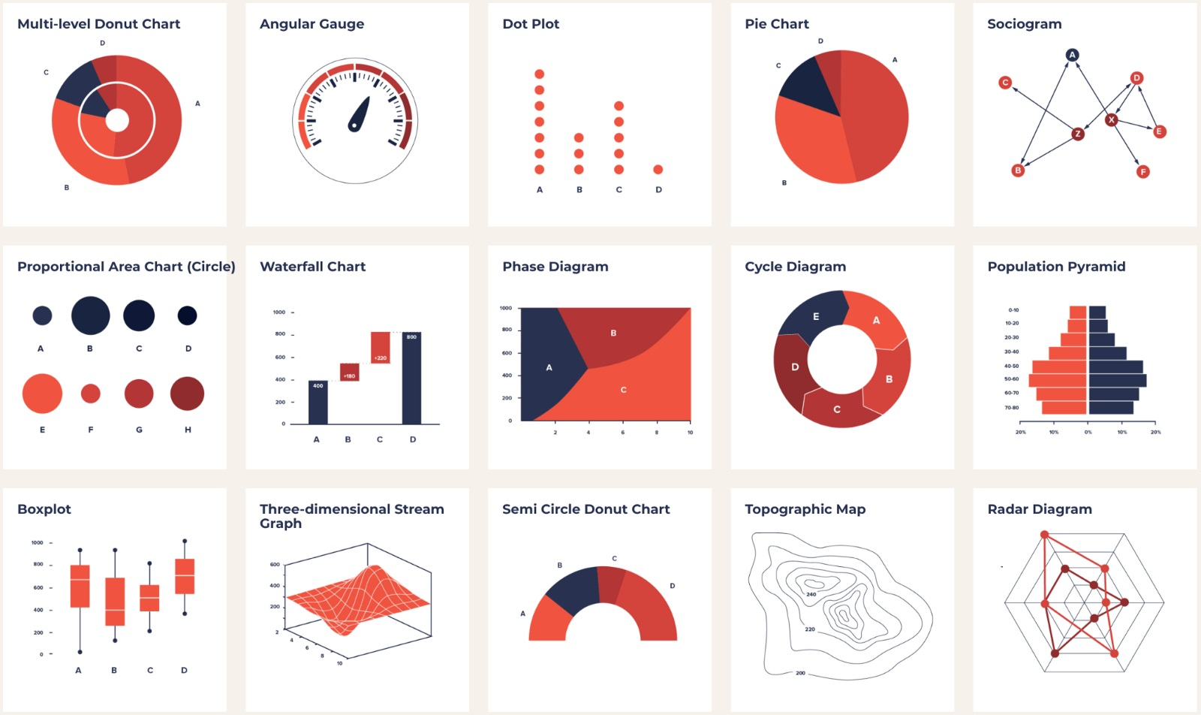
Visualization and Report Building
Visual Elements Used:
Bar Chart: Number of titles per year
Pie Chart: Genre distribution
Map: Country-wise content contribution
KPI Cards: Total titles, movies, and TV shows
Table: Top 10 directors by number of titles
Design Principles:
Clean, intuitive visuals with consistent color themes
Filters for content type, country, and genre
Tooltips for extra info (e.g., director names, release year)

Slide 8
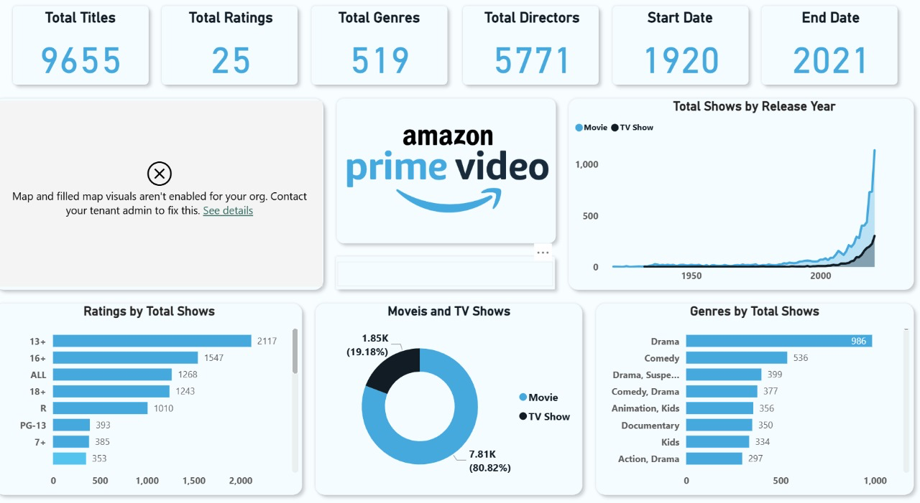
Dashboard and Publishing
The final dashboard was published to Power BI Service.
Stakeholders can explore and interact with visuals online.
Data refreshes can be automated when linked to updated datasets.
Enhances collaboration and ensures up-to-date analytics.

Slide 9

Insights and Findings
Content Growth: Rapid increase in titles after 2015 due to streaming expansion.
Top Genres: Drama, Comedy, and Documentaries dominate the platform.
Country Insights: Majority of content comes from the United States, India, and the UK.
Director Analysis: A few directors have multiple titles, indicating strong partnerships.
Movie vs. TV Shows: Movies constitute ~70% of the total content.
These insights highlight global entertainment trends and Amazon Prime’s content diversity.
This Photo by Unknown Author is licensed under CC BY-SA

Slide 10

Best Practices and Tips
Maintain consistency in visuals and color themes.
Use slicers to enable dynamic filtering.
Minimize complex DAX calculations for faster report refresh.
Validate dashboard data regularly for accuracy.
Include explanatory tooltips and legends for better readability.
This Photo by Unknown Author is licensed under CC BY-SA-NC

Slide 11

Conclusion
This Power BI dashboard provides a data-driven view of Amazon Prime Video’s content landscape.
It demonstrates how raw data can be transformed into interactive visual insights, helping analysts and media strategists make informed decisions about content trends and audience preferences.

Slide 12
Appendices
Dataset: amazon_prime_titles.csv
Tools: Microsoft Power BI, Power Query, DAX
References:
Power BI Official Documentation
Kaggle Amazon Prime Titles Dataset
Tutorials on Power BI Dashboard Design

Slide 13

DONE BY:
Hujjathullah S T (RA2212704010035)
Sandeep kumar (RA2212704010036)
Deepika Elsa Joseph (RA2212704010037)
Suresh Krishna (RA2212704010038)
Pragati (RA2212704010040)

